Slide 1

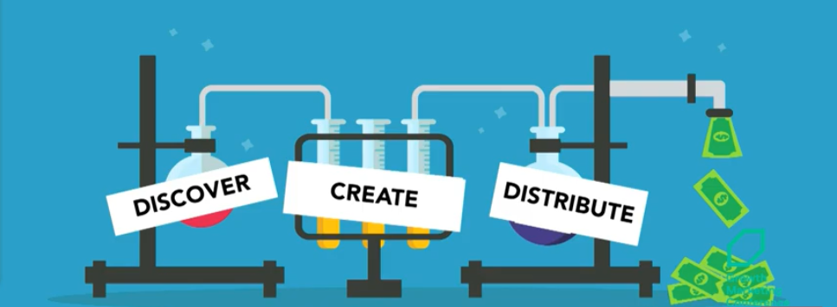
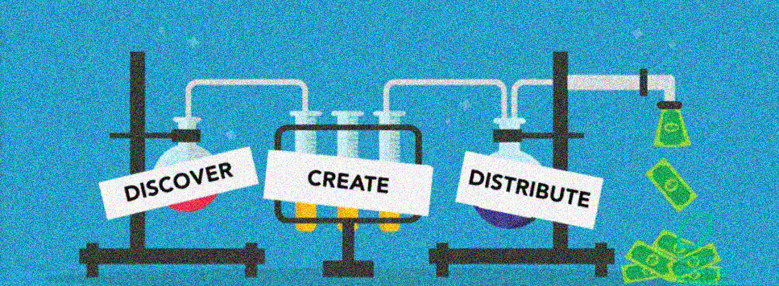
B2B Content Distribution Strategies
GAGGLEBOX
MEDIA
&
Influencer Marketing’s Role in It
Created & Curated by:
Saurav Banerjee

Slide 2

Why This Guide
To provide a step-by-step methodology on creating more interaction around limited but focused content.
Content distribution - why now?
How to distribute a piece of content?
How to map your audience personas?
How to run a successful content marketing audit?
Which channels to distribute your content to?
How do influencers fit this picture & why would they help you?
What kind of content should fuel your buyer journeys?
How to track your content distribution efforts?
The final distribution checklist
Packaging your offerings for clients
Appendix – Intelligent Tools & Framework

Slide 3

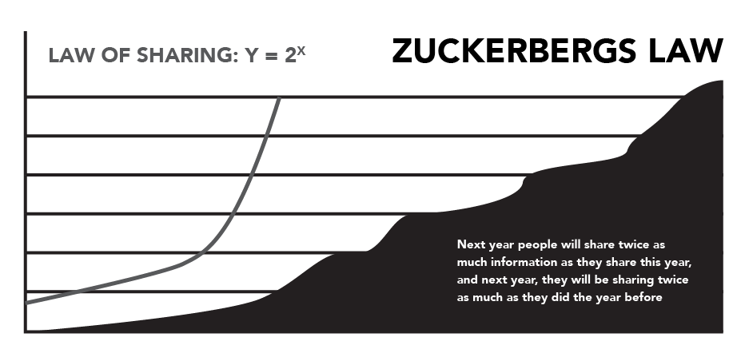
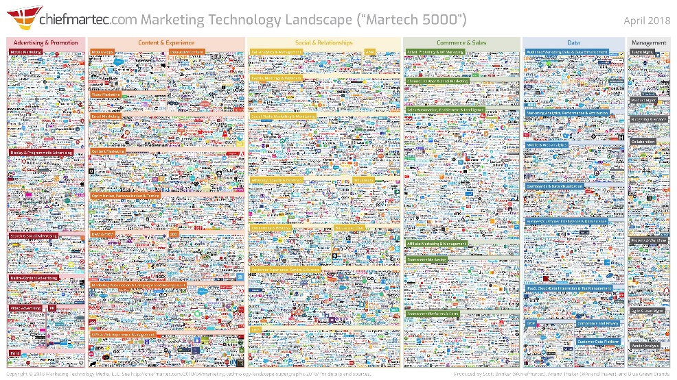
Content Distribution- Why Now?
ONLY
PROMINENT VOICES CAN RISE ABOVE THE
NOISE!!!
More content shared than ever before.
More channels to share than ever before.
More competition than ever before.
Source: https://rosssimmonds.com/content-distribution/
Mark Zuckerberg predicts the rate of online “sharing” is going to only grow exponentially year after year.
Martech-5000 landscape listed 7,000+ martech companies in 2018, which has only grown since.

Slide 4



















The Content Distribution Circle
Twitter:
Tweet storm announcing the release
This is where you require INFLUENCERS!
Audience Intelligence Tools
Map audience personas with certainty
Facebook:
Image posts with snippets from original content
Social Schedulers
Higher reach, relevant audience
Instagram:
Stories, Carousel with link in bio
LinkedIn:
Launch teaser video with snapshots from asset
Email:
Newsletter, preferably in text, mentioning all assets
RESHARE
Reddit:
Publish similar post with link to original piece
Snapchat:
POV story teasers
Medium:
Import original piece to Medium native
Create snippets for post with CTA to original content
Communities:
Engage in discussions on Facebook & LinkedIn groups, SubReddit pages, Slack communities. Subtly mention assets.
ORIGINAL CONTENT
REMIX
SlideShare:
Create PPT from information on original asset.
REPOST
Industry Forums:
Identify niche forums with relevant audience. Distribute content links.
YouTube:
Create bite-sized videos with snapshots from original piece
3R’s of Content Distribution
Quora:
Gain upvotes by answering relevant queries with links to your valuable content.
LinkedIn:
Re-publish as LinkedIn article

Slide 5
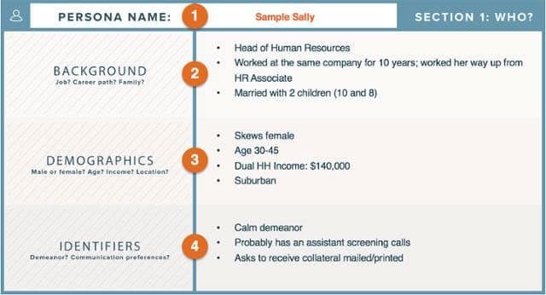
Whom to Distribute Your Content to
Mapping your audience personas:
How to gauge them:
Where to find them:
Demographic Data | Psychographic Data
What are their age and gender? Where do they live? Are they single or married? Do they have children? Where do they work (industry and niche), and what is their job role? What is their net income? | How do they think? What are their goals? What are the pain points and challenges they face? What are their interests, likes, and dislikes?
Social Channels
Communities
Subscriber List
Industry Forums
Intelligence Tools
Source: Marketing Insider Group – Content Distribution Blog

Slide 6
Comprehensive Content Audit: 1
1.
Define the
SCOPE
From Inventory to Audit:
Step 1: Compile and catalogue all previous existing brand materials and collaterals.
Step 2: Define your commercial objectives through comprehensive KPIs.
Step 3: Establish viable means to collect authentic information in support of your objectives.
branding
SEO
website
social
offline
competitor
2.
Define the
GOALS
Online Assets → | PRODUCT | PRICE | PROMOTION | PLACE
Traditional Assets → | COMMODITY | COST | COMMUNICATION | CHANNEL
K
P
I
Brand mentions
Reviews
Customer ratings
Link profile / authority
Organic rankings
Click-through rates
Conversions
Business referrals
Press coverage
Trade show connections
Speaking engagements
Market share
Organic position
Brand reach
Customer perception
Page speed
User Experience
Indexability / Crawlability
Engagement
Social lift
Industry influence
3.
Define the
MEANS
TOOLS
Milestone Insights (MPC)
SEMrush
Searchmetrics
Google Analytics
Google Search Console
BuzzSumo
Rival IQ
Twitter/LinkedIn Analytics
Facebook Insights
SparkToro
Content Marketing Vendors
Event Marketing Agencies
Influencer Marketing Agencies
Screaming Frog
Raven Tools
PageSpeed Insights
Lighthouse
SEMrush
Ahrefs
MarketMuse
SpyFu
Mention
Google Alerts
Source: Brafton Blog - Comprehensive Marketing Audit in 10 Steps

Slide 7
Comprehensive Content Audit: 2
4.
Define
PRIORITIES
From Audit to Insights:
Step 4: Create a Priority Checklist mentioning all audit findings.
Step 5: Assign SMART achievable actions against the findings.
branding
SEO
website
social
offline
INSIGHT
Expand, consolidate or refine social media channels.
Reclaim unlinked brand mentions.
Respond to user reviews on Google My Business and other online directories.
Pinpoint gaps in existing content.
Formally update brand guidelines / messaging.
Address all site penalties.
Clean up any analytics-tracking errors.
Test for additional CRO and UX opportunities.
Identify organic ranking opportunities easily within grasp.
Optimize high-conversion pages and metadata.
Identify future networking, publication and industry-specific possibilities.
5.
List Convertible
ACTIONS
ACTION
Improve Domain Authority five points by guest-posting on high-value industry sites and promoting external links.
Drive two new sales-ready local leads monthly through Local SEO and word of mouth.
Produce 10-15 new conversion landing pages based on high-value keyword targets.
Include one video or animation in social posts per week, varied across channel.
Increase trade show attendance from two to eight this year for stronger networking and physical marketing presence.
*Examples only
Source: Brafton Blog - Comprehensive Marketing Audit in 10 Steps

Slide 8
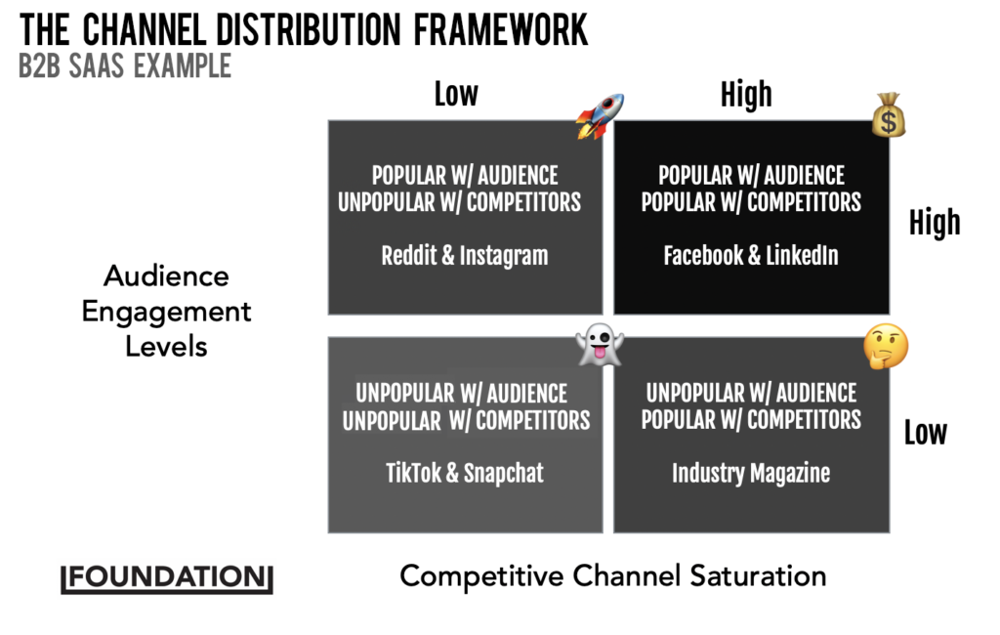
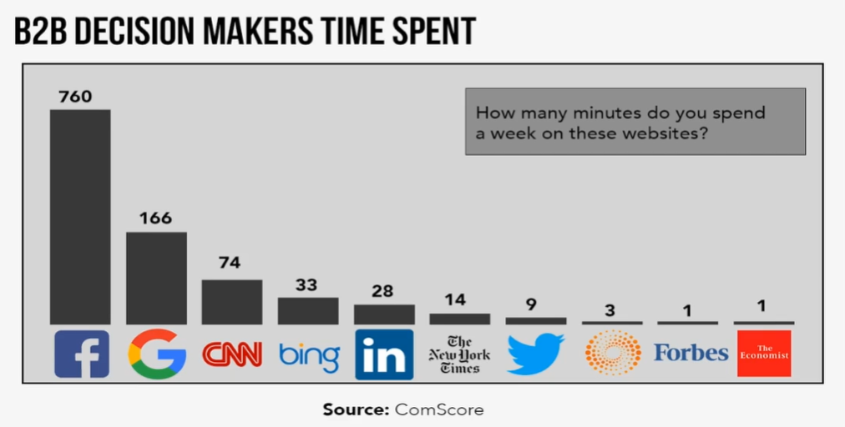
Where to Distribute Your Content
Rocket Channels:
Popular but risky, these channels can unlock unprecedented growth.
Money Channels:
Established channels for continuous results. Sometimes costly.
Ghost Channels:
Channels with doubtful future gains, only with the hope of early-bird advantage.
Questionable Channels:
Channels saturated with competition, but with some scope to penetrate your current audience.
Source: https://rosssimmonds.com/content-distribution/
Facebook Groups have
1B+
USERS
per month

Slide 9

How Do Influencers Fit This Picture?
“A brand can never be able to have the perspective of standing in the shoes of a consumer. They are still the maker of the product, and what’s influencing consumers is like-minded voices, peers and people in their situations.”
Why do I Need Them?
Holly Hamann
Co-Founder, TapInfluence
Who Are They?
What Can I Make Them Do?
Influencers have a pre-established audience who trust their recommendations over yours.
They have on-ground experience and perspective to know the right time, place, and people to distribute your content.
Bloggers
Customers
Members of a Purchasing Group
Industry Experts & Analysts
Business Partners
Internal Team Members or Experts
List of Pilot Projects:
Ask for a quote for an article.
Request to speak at a conference.
Ask to join or be a guest on a Twitter chat or webinar.
Provide a quote for an eBook.
Gather responses on a specific topic for a crowdsourced blog post.
Request permission to share or link to their content.
Request information or data for a case study.
Ask to write a guest blog post, or feature in one.
Include them in an expert panel at an industry event.
Ask to be a guest on a podcast or Google Hangout.
Source: CMI Influencer Marketing eBook

Slide 10
Why Would Influencers Help You?
Things you need to discuss during the briefing:
Audience: | Whom do you want to influence? | Who do you want your influencer to engage? Give them as broad an understanding of the audience as you have or the ones you want to target.
Objectives: | What are the influencer’s objectives? | What do you want the influencer to do? Tie this back to your own KPIs, so if you want shares, actions, likes, tell the influencer now. Clearly define your expectations now (number of posts, number of comments, click-through rate) and your time limits, or it will cause issues later
End-user Gains: | Why would the influencer’s audience be interested? | Why should your influencer’s audience engage? For this, brief your influencer as you would an agency. You have defined them as an influencer that aligned with your brand philosophy, so you now need to introduce them to your brand. Highlight your USPs, brand purpose, campaign ideas, and anything else that would inspire. Don’t constrict your influencer. You are using them for their creativity, and by limiting their abilities, you will lose the authenticity (and impact) of your campaign.
Relevant Materials: | What can you share with them? | Provide any essential marketing materials the influencer may need. Images, logos, straplines, product samples, etc, etc.
Incentive Package: | What would the influencers get out of it? | How much are you willing to offer your influencer for their work on this campaign? It’s best to cross this hurdle now, rather than wait until further down the line and risk complications. But don’t automatically assume payment is needed. Some micro-influencers would be happy to accept goods for payment.
Source: TalkWalker Influencer Marketing Guide

Slide 11
Micro-Content to Create across Buyer Journeys
PRODUCT TUTORIALS
EDITORIAL
EXPERT REVIEWS
TRIAL REGISTRATIONS
LIVE DEMO
EBOOKS
WHITEPAPERS
CASE STUDIES
EVENTS
RESEARCH REPORTS
EDUCATIVE BLOGS
PRODUCT COMPARISONS
PUSH NOTIFICATIONS
AWARENESS
(Focusing on a new product or a new market)
CONSIDERATION
(Focusing on nurturing the leads from last year)
CONVERSION
(Focusing on big numbers and revenue)
ADVOCACY
(Focusing on customer retention & advocacy)
ANALYST REPORTS
EXPERT GUIDES
VENDOR COMPARISONS
SOCIAL INBOX
LIVE INTERACTIONS
COMPARATIVE ANALYSIS REPORTS
VALUE-ADD CAMPAIGNS
VIDEOS
WEB- / POD-CAST
THOUGHT LEADERSHIP ARTICLES
Deployment of Relevant Content across the Customer Engagement Funnel:
AWARENESS | CONSIDERATION | CONVERSION | ADVOCACY
Analyst Reports | Expert Guides | Vendor Comparisons | Events
Research Reports | Live Interactions | Product Comparisons | Push Notifications (PWA)
eBooks | Web- / Pod-cast | Case Studies | Social Inbox
Editorial | Interactive Videos | Free Trial Registrations | Value-add Campaigns
FAQ Module | Comparative Analysis Reports | Product Tutorials | Thought Leadership Articles
Whitepapers | Infographics | Live Demo
Educative Blogs

Slide 12
Tracking Your Content Distribution Efforts
Marketing Stages: | AWARENESS |  | CONSIDERATION | DECISION-MAKING | POST-PURCHASE
Objectives: | REACH | PERCEPTION | ENGAGEMENT | CONVERSION | SATISFACTION & ADVOCACY
Content Distribution KPIs | Impressions Views Publication pickup Social content metrics Organic traffic (SEO) | Brand indexes / surveys Social sentiment Shares Reviews Comments | Traffic Time on site Lead gen rate Leads (not yet qualified) | Leads Qualified leads MQLs SALs, SQLs | Product usage Customer review scores Product registrations Account renewals Product return rate Social fans/follows
Source: ColumnFive Media – Content Distribution Metrics Blog
Objectives: | Influencer Marketing KPIs
BRAND AWARENESS | Website traffic • Page views • Video views • Document views • Downloads • Social chatter • Referral links
ENGAGEMENT | Blog comments • Likes, shares, tweets, +1s, pins • Forwards • Inbound links
LEAD GENERATION | Form completions and downloads • Email subscriptions • Blog subscriptions • Conversion rate
SALES | Online sales • Offline sales • Manual reporting and anecdotes
CUSTOMER RETENTION / LOYALTY | Percentage of content consumed by existing customers • Retention/renewal rates
UPSELL / CROSS-SELL | Sales for new products / services
Check our Influencer Tracker Here: Milestone Influencer Marketing Dashboard
Source: CMI Influencer Marketing eBook

Slide 13
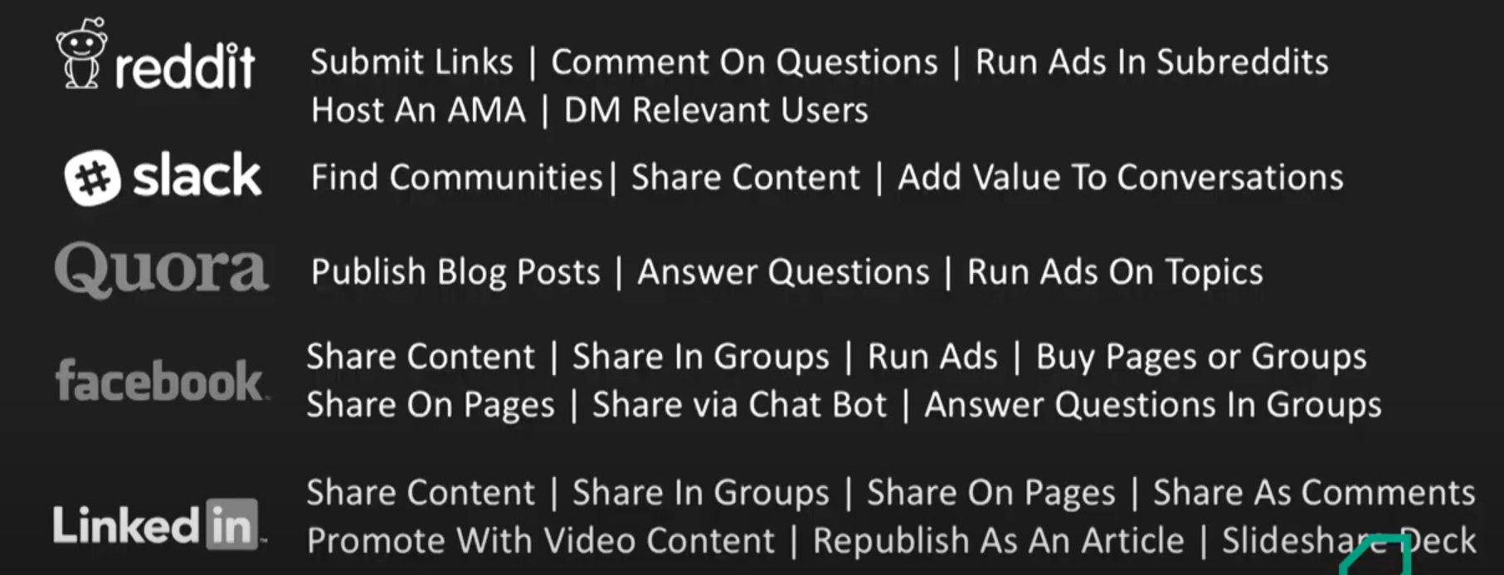
Content Distribution Checklist
Source: Going beyond the Distribution Basics – Ross Simmonds Keynote
Find the Full Checklist Here: Ross Simmonds – Content Distribution Checklist

Slide 14
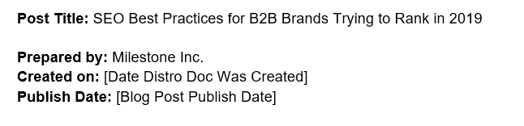
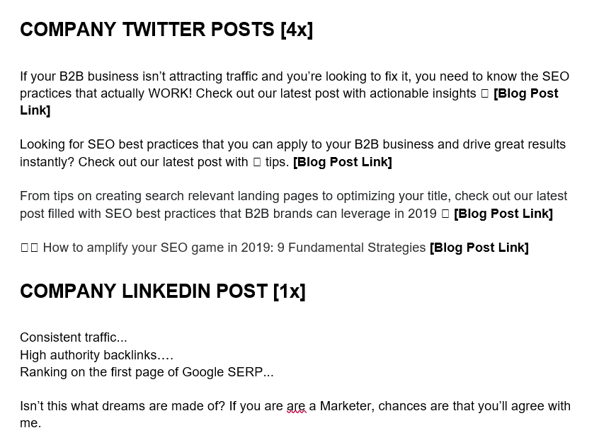
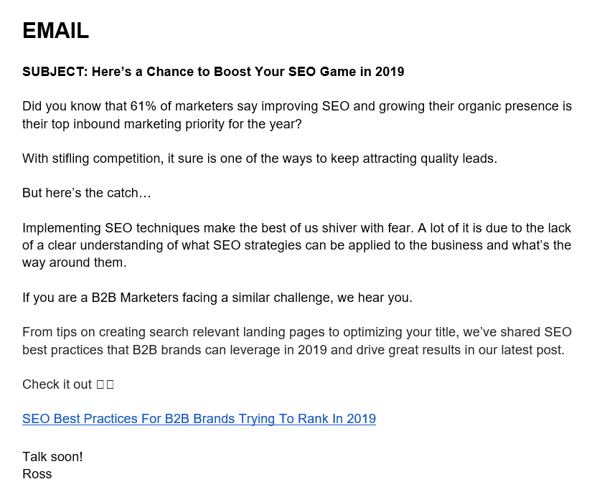
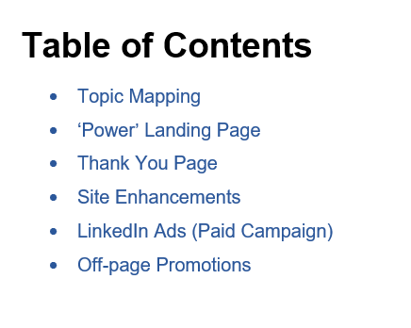
Package Offerings – The Distro Doc
Combine all your post-publication strategies neatly in a document.
This should accompany your media & content strategy presentations.

Slide 15
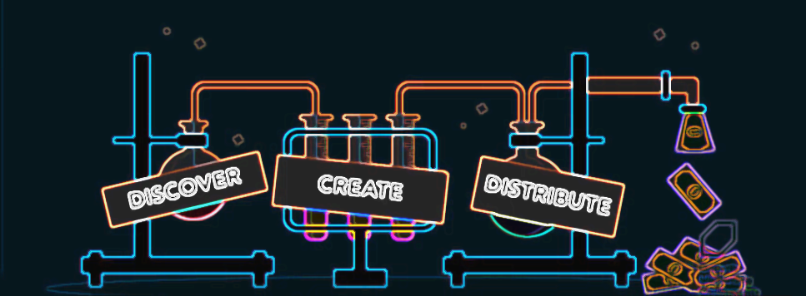
Appendix
Intelligent Tools & Impact Framework to Keep Your Success in Check

Slide 16
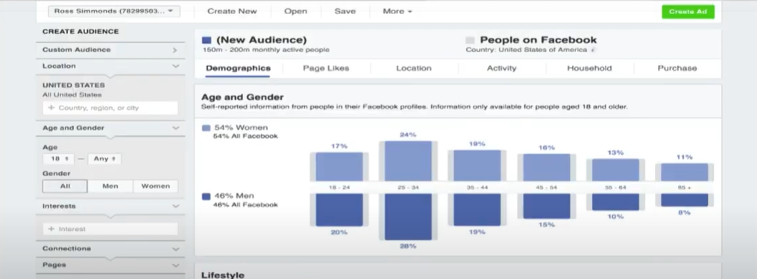
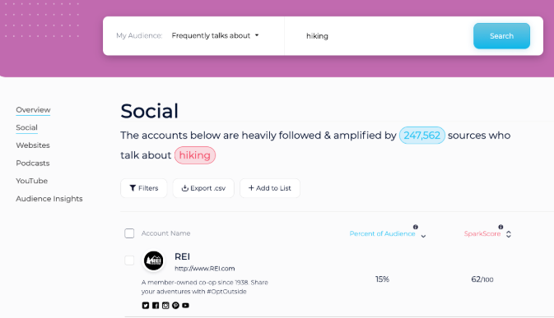
Discover Audiences with Intelligence Tools
Audience Intelligence Tools:
Tools also frequented for INFLUENCER PROGRAMS!
Facebook Audience Insights
Content Campaign Vendors
Learn more about your target audience clusters by comparing them to other Facebook populations.
Search Filters:
DEMOGRAPHICS
PSYCHOGRAPHICS
GEOGRAPHY
PURCHASE BEHAVIOR
TapInfluence • BzzAgent • Markerly • Social Media Link • Influitive • SocialChorus • Ivy Worldwide
Discovery & Connection Tools
Visible Technologies • CMP.L • Commun.it • Traackr • Little Bird • GroupHigh • Insightpool
Learn More
SparkToro
Look into your audiences’ minds with actionable insights from their recent digital footprints.
Search Filters:
FREQUENTLY DISCUSSED TOPICS
WORDS/PHRASES USED MOST
SOCIAL ACCOUNTS FOLLOWED
WEBSITES MOST VISITED
FREQUENTLY USED HASHTAGS
Content Distribution Tools
InPowered • GaggleAMP • HubSpot • Buddy Media • Medium • LinkedIn • Ezine
Source: Content Marketing Institute
Learn More

Slide 17
Distribution Framework to Harness Maximum Impact
MICRO CONTENT FUNNEL
AUDIENCE & DEMAND STRATEGY
Persona Mapping Sheets, Demand Funnels, Omni-channel Strategy Deck
UNIVERSAL SEARCH OPTIMIZATION
MARKETING MILESTONES
SWOT, Competitor Study, Market Research Reports
SERP & CTR OPTIMIZATION
Maximizing Effective REACH
Increasing Relevant CONVERSIONS
Meta-data Optimization, Rich Snippets with relevant value-driven content
Relevant FAQs, Long-tail Search Queries
A
E
CO-OPTIMIZATION
Social & Paid campaigns, Email Marketing
CONVERSATIONAL SEARCH OPTIMIZATION
On-page authority + engagement with blogs, back-links, Local Optimization
AUTHORITY
BUILDING
R
C
Pop-ups, Event Calendar, PWA Notifications
Driving Considerable ACTIONS
Nurturing Customer ENGAGEMENTS
DIGITAL ASSET
OPTIMIZATION
Omni-channel Content Calendar with KPI Scorecards, QBR, Case Studies
This framework ensures effective implementations of each content marketing strategy across the buyer journey.
MEASUREMENT
& TRACKING

Slide 18
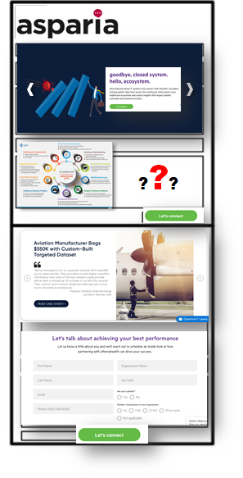
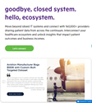



Package Your Asset through “Power” Landing Pages
Combining all of marketing's best into one 'power'-packed landing page!
Establish clear hierarchy between topics, pages to improve reach.
Add customer-centric message and review-based content to imbibe authority & credibility.
YOUR CAMPAIGN DRIVERS
Paid Social (LinkedIn)
Focus on visual representations that visitors can interact with, like infographics.
Answering relevant questions help invoke actions from users & help you appear in Voice Search.
PPC (Google Ads)
Blog Content
Email
SAMPLE CTAs
Add catchy CTAs throughout the page to improve CTR and Conversions.
DOWNLOAD EBOOK
3rd Party Expertise
EXPERIENCE FOR YOURSELF
Brand Amplification
POWER PAGE
STRUCTURE

Slide 19
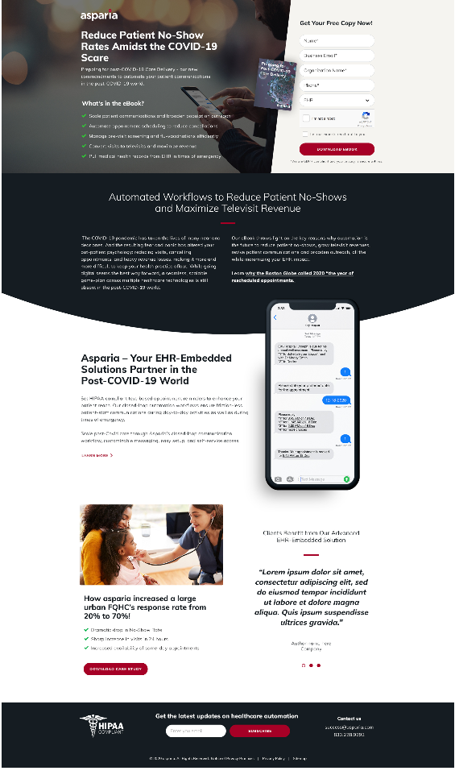
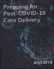
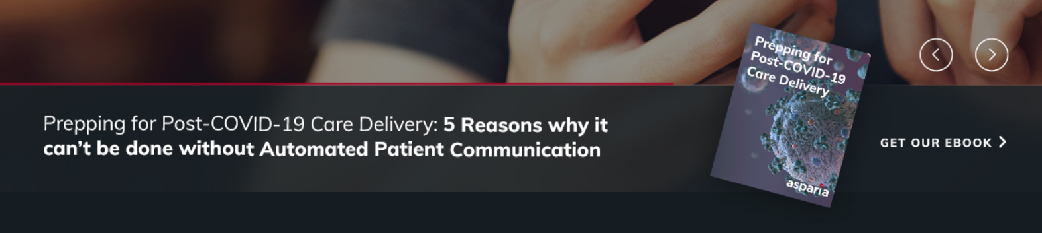
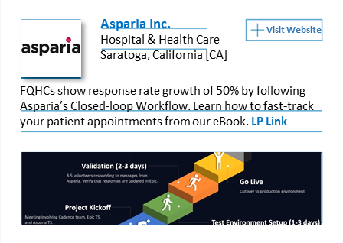
Distributing Content Asset across Channels: Example
Power Landing Page X 1
Site Enhancements
COVID-19
CARE DELIVERY
_______
EBOOK
LinkedIn Ads X 3
Off-Page Promos

Slide 20
Resources
CMI Influencer Marketing eBook
Marketing Insider Group – Content Distribution Blog
Brafton Blog - Comprehensive Marketing Audit in 10 Steps
TalkWalker Influencer Marketing Guide
ColumnFive Media – Content Distribution Metrics Blog
Ross Simmonds – Content Distribution Checklist

Slide 21
GAGGLEBOX
MEDIA
IT’S NOT JUST TALK.
Reach the creator at:
www.sauravbanerjee.com

